Slide 1
Data Analysis Review
Overview
In this lesson, students will review the Data Analysis unit and explore paths for continued development.
Duration 120 minutes
Learning Objectives
In this lesson, students will:
Review Data Analysis concepts in Pandas
Explore paths for continued development in Data Analysis

Slide 2
Pre-Class Materials and Preparation
For remote classrooms: Virtual breakout rooms and Slack may be needed to facilitate the partner exercise and discussions. As you plan for your lesson:
Consider how you’ll create pairs for the partner exercise (randomly, or with pre-assigned partners).
Determine how (if at all) exercise timing may need to be adjusted.
For helpful tips, keep an eye out for the For remote classrooms tag in the speaker notes.
Prepare screenshots and answers to exercises in advance so that they can be easily shared in Slack during your lecture.

Slide 3
Suggested Agenda
Time | Activity
0:00–1:30 | Unit Lab Solution(s)
1:30-2:00 | Data Analysis Next Steps and Review

Slide 4
Jupyter Notebook
The exercises referenced in this lesson can be found in the Python Workbooks + Data folder.

Slide 5
Data Review and Next Steps

Slide 6
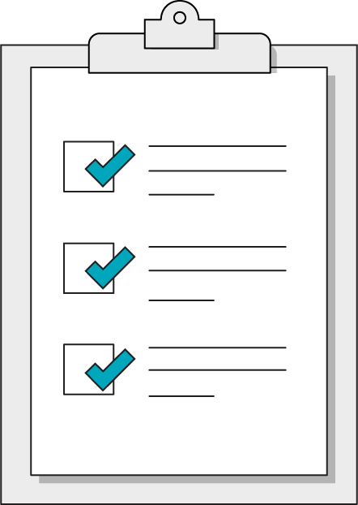
Today’s Learning Objectives
In this lesson, you will:
Review Data Analysis concepts in Pandas
Explore paths for continued development in Data Analysis
‹#› | © 2020 General Assembly
Notes:
Purpose: Set expectations for the lesson.
For remote classrooms:
Capture a screenshot of this slide and drop it in the class Slack channel.

Slide 7
Pandas Review
Data Analysis Review
Notes:
Duration: 15 minutes

Slide 8
Data Analysis Unit Lab Solutions
1 hour 30 minutes
Let's review solutions for the Unit Lab with a guided review session.
Notes:
Take any questions about the Data Unit Lab while walking through solution code step-by-step, prompting students for ideas at each part of the lab.

Slide 9
Reflective Review of Pandas
Rate your confidence in the following statements so we can review concepts from Pandas as necessary:
Given a .csv file, I can use Pandas to explore the data at a high level
I can filter and sort data to explore specific aspects of a data set
I can clean a data set to deal with missing and nonstandard values
I can create clear data visualizations to tell the story of a data set
I can combine data from multiple sources into a single Data Frame
I can use groupby to perform segment analysis
Notes:
Ask students to rate their confidence on a scale of 1-5, then take questions on the topics that get the lowest overall ratings.

Slide 10
Next Steps in Data Analysis
Data Analysis Review
Notes:
Duration: 10 minutes

Slide 11
Data Analysis Technologies
Python is an extremely flexible tool for data analysis needs, and can provide a level of depth and customization that can be difficult to impossible to achieve with non-programming technologies. However, a well-rounded Data Analyst can enhance their skills with other commonly used tools:
SQL databases and Python libraries such as SQLAlchemy
Tableau or Power BI for self-serve data dashboards and visualizations
Excel for accessible, dynamic spreadsheets and workbooks

Slide 12
Data Visualization
Although we've used Pandas' basic plotting features, there's a lot more to learn in matplotlib. Consider the following aspects of data visualization:
Modifying display properties to create dynamic, engaging visuals
Explore the wide range of visualization types available
Combine multiple charts in a single visualization
Apply regression analysis to a data set to plot the line of best fit

Slide 13
Data Engineering
Data science techniques like neural networks may get the spotlight, but models are only as reliable as the data they're given. Data Engineering is attracting more attention as the necessary foundation for effective, advanced data modeling. Data engineering involves deeper study of:
Handling missing values in a data set
Standardizing data formats and values between multiple sources
Feature engineering to create more robust data sets

Slide 14
Data Modeling
Although advanced data science requires more statistics and mathematical foundations, there are a large collection of Python libraries that make complex data modeling accessible to anyone comfortable learning new Python libraries.
SciPy
Keras
SciKit-Learn
PyTorch

Slide 15

Don’t Forget: Exit Tickets!

